Slide 1
Intensity Transformations and Spatial Filtering
Digital Image Processing
Dr. Muhammad Sajjad
R.A: Muhammad Abbas

Slide 2
Overview
Basic Concepts
Intensity transformation and spatial filtering
Basic intensity transformation functions
Piecewise linear transformation functions
Histogram processing

Slide 3
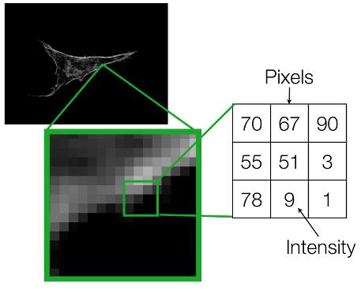
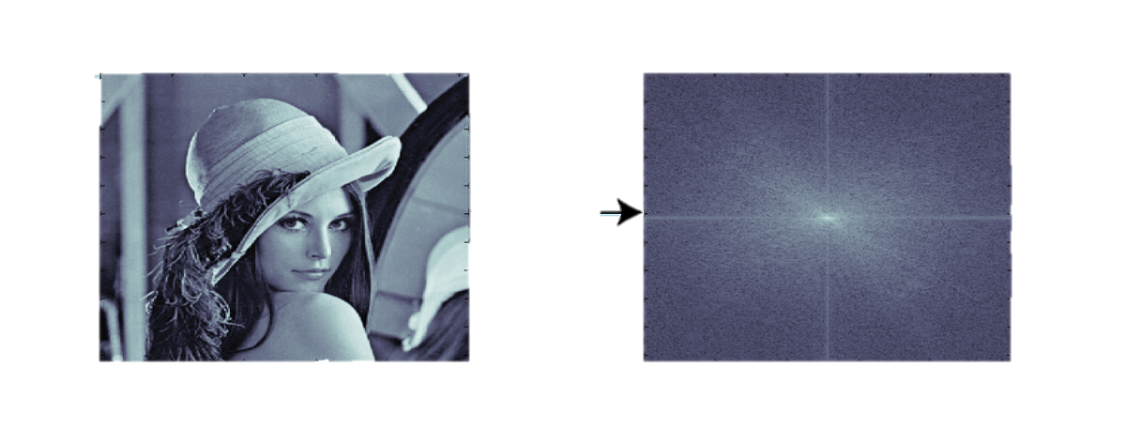
Basic Concepts
Spatial Domain
Image plan itself, direct manipulation of pixels in an image.
Transform Domain
Process the transform coefficients, not directly process the intensity values of the image plane
E.g. In frequency domain operations are performed on the Fourier transform of an image.
Fourier transform
Spatial Domain
Frequency Domain

Slide 4
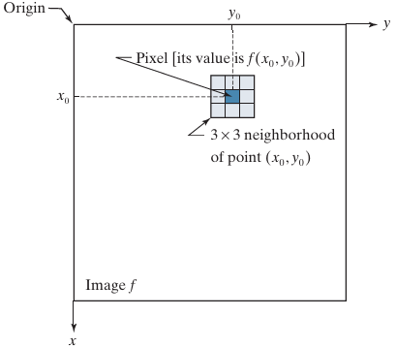

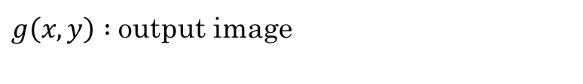
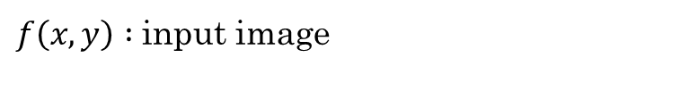
Basic Concepts
Spatial Domain Process
$$g\left(x, y\right)=T\left[f\left(x, y\right)\right]$$
$f\left(x, y\right) :$input image
$g\left(x, y\right) :$output image
T : An operator on f defined over a neighborhood of point (x, y)
A 3 x 3 neighborhood about a point (x₀ , y₀) in an image. The neighborhood is moved from pixel to pixel in the image to generate an output image.

Slide 5
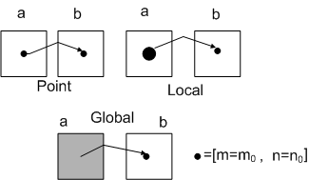
Basic Concepts
Types of operations in spatial domain
Point/pixel Operations
Output value at specific coordinates (x, y) is dependent only on the input value at (x, y)
In this case the neighborhood is 1x1
s = T(r)
Local Operations
The output value at (x, y) is dependent on the input values in the neighborhood of (x, y)
Global Operations
The output value at (x, y) is dependent on all the values in the input image

Slide 6
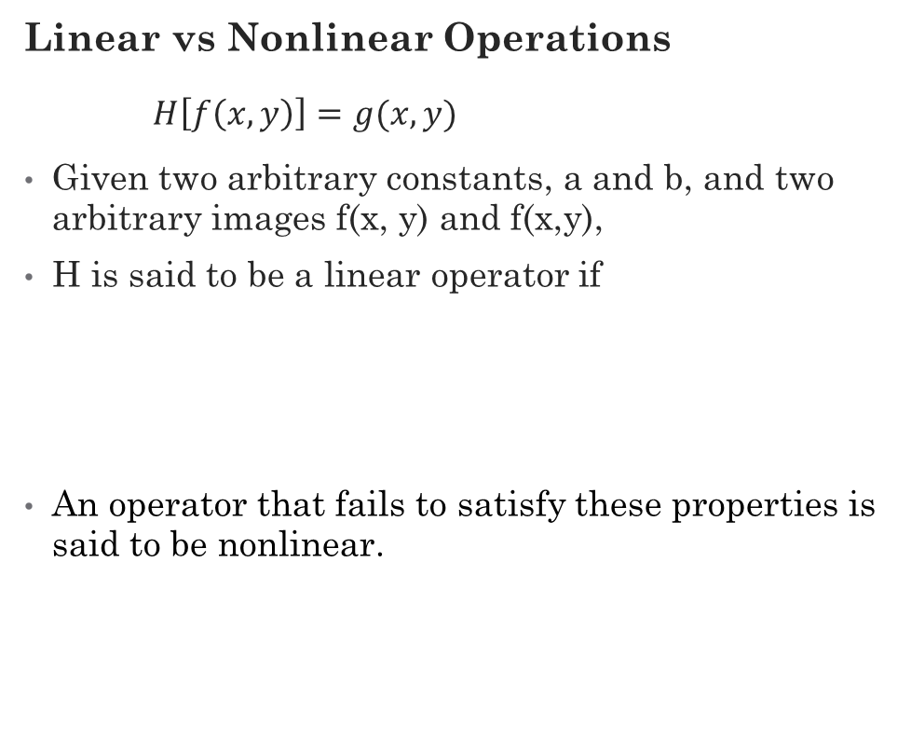
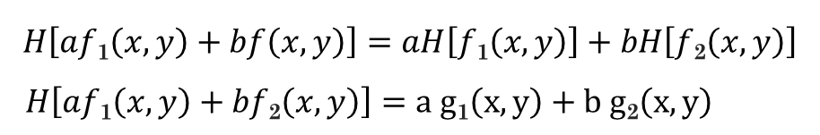
Basic Concepts
Linear vs Nonlinear Operations
$H\left[f\left(x, y\right)\right]=g(x,y)$
Given two arbitrary constants, a and b, and two arbitrary images f(x, y) and f(x,y),
H is said to be a linear operator if
An operator that fails to satisfy these properties is said to be nonlinear.
$$H\left[af\text{1}\left(x,y\right)+bf\left(x,y\right)\right]=aH\left[f\text{1}\left(x,y\right)\right]+bH\left[f\text{2}\left(x,y\right)\right]$$
$$H\left[af\text{1}\left(x,y\right)+bf\text{2}\left(x,y\right)\right]=a g\text{1}\left(x,y\right)+b g\text{2}\left(x,y\right)$$
→ Additivity
→ Homogeneity
Examples
Linear => sum operator
Nonlinear => max operator

Slide 7
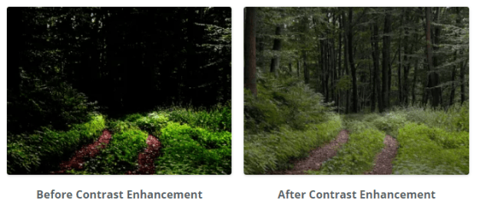
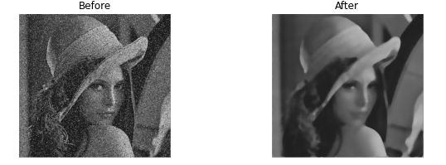
Intensity Transformation and Spatial Filtering
Intensity Transformations
Intensity transformations operate on single pixels of an image
E.g. Contrast manipulation, image thresholding
Spatial Filtering
Performs operations on the neighbor hood of every pixel in an image
E.g. image smoothing and sharpening
Image Enhancement
Process an image to make the result more suitable than the original image for a specific application
Image enhancement is subjective (problem oriented)
Intensity transformation and spatial filtering techniques are often used for image enhancement

Slide 8
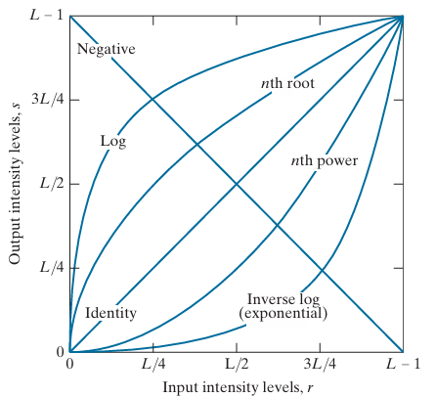

Basic Intensity Transformation Functions
Image Negatives
Applications
Enhancing white or gray detail embedded in dark regions.
$$s=L−1−r$$
L = 256
0 | 50 | 200
60 | 128 | 30
186 | 255 | 40
255 | 205 | 55
195 | 127 | 225
69 | 0 | 215
Some basic intensity transformation functions

Slide 9
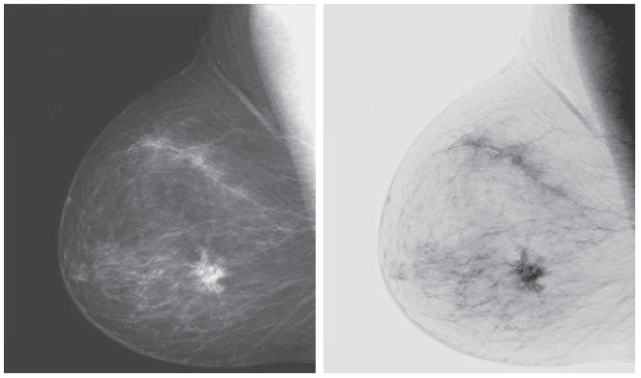
Basic Intensity Transformation Functions
Image Negatives
A digital mammogram
Negative image obtained using image negatives

Slide 10
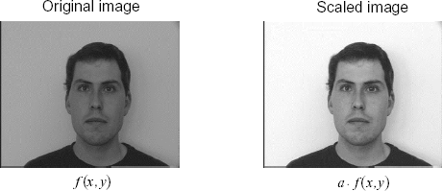

Basic Intensity Transformation Functions
Image Scaling
$$s=T\left(r\right)=a.r$$

Slide 11
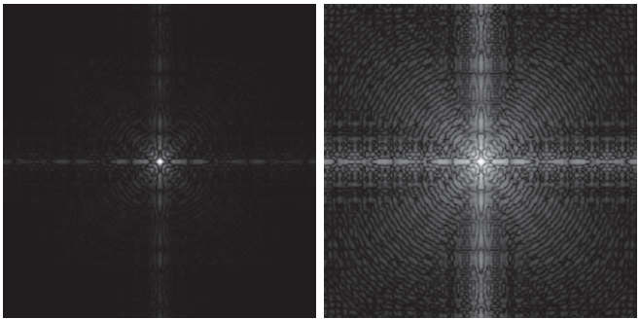

Basic Intensity Transformation Functions
Log Transformations
Used to expand the values of dark pixels in an image, while compressing the higher-level values.
Applications
This transformation is suitable for the case when the dynamic range of a processed image far exceeds the capability of the display device (e.g. display of the Fourier spectrum of an image)
Also called “dynamic-range compression / expansion”
$$s=c log⁡(1+r)$$
Fourier spectrum displayed as a grayscale image
Result of applying the log transformation with c=1

Slide 12
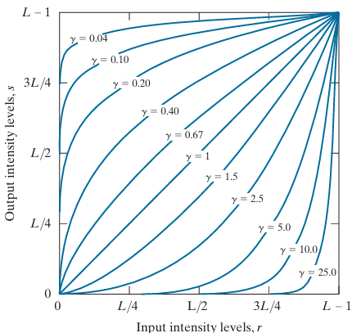
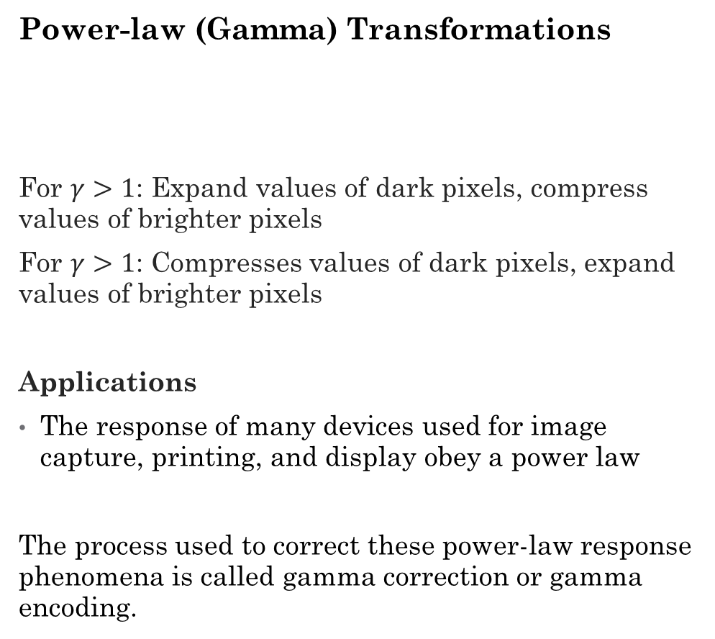

Basic Intensity Transformation Functions
Power-law (Gamma) Transformations
For $γ>1$: Expand values of dark pixels, compress values of brighter pixels
For $γ>1$: Compresses values of dark pixels, expand values of brighter pixels
Applications
The response of many devices used for image capture, printing, and display obey a power law
The process used to correct these power-law response phenomena is called gamma correction or gamma encoding.
$$s=c r^{γ}$$
Plots of the gamma equation for various values of gamma (c =1 in all cases)

Slide 13
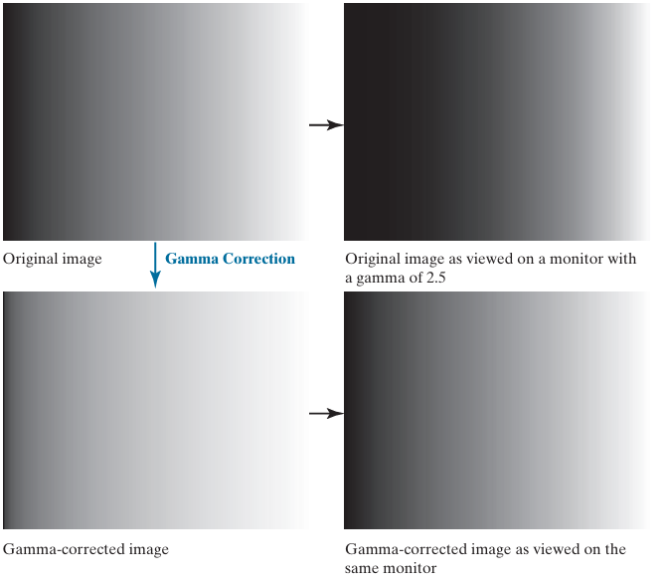
Basic Intensity Transformation Functions
Power-law (Gamma) Transformations
Response of CRT to Linear wedge
Output of monitor

Slide 14
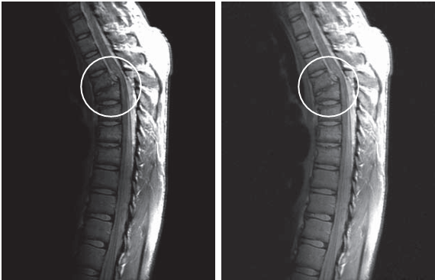
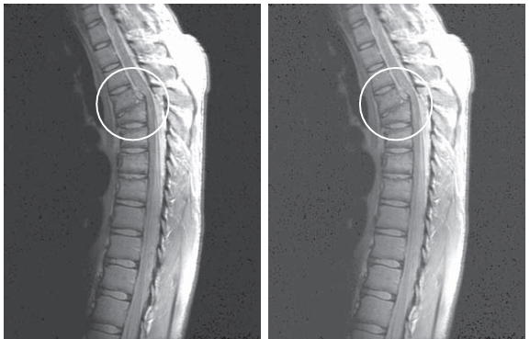
Basic Intensity Transformation Functions
Power-law (Gamma) Transformations
MRI image of fractured human spine
Result of applying power-law transformation
c = 1, γ = 0.6
Result of applying power-law transformation
c = 1, γ = 0.4
Result of applying power-law transformation
c = 1, γ = 0.3

Slide 15
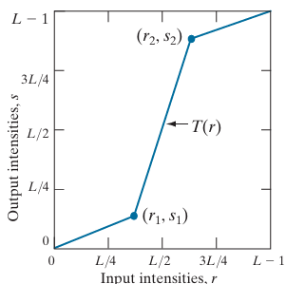
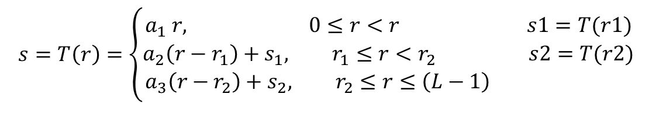
Piecewise Linear Transformations
Contrast Stretching
Increasing the dynamic range of the gray levels for low contrast images.
Low-contrast images can result from
Poor illumination,
Lack of dynamic range in the imaging sensor, or
Wrong setting of a lens aperture during image acquisition
$$s=T\left(r\right)=\left\{\begin{aligned}a_{1} r, 0≤r<r s1=T(r1) \\ a_{2}\left(r−r_{1}\right)+s_{1}, r_{1}≤r<r_{2} s2=T(r2) \\ a_{3}\left(r−r_{2}\right)+s_{2}, r_{2}≤r≤\left(L−1\right) \end{aligned}\right.$$

Slide 16

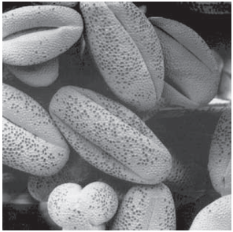
Piecewise Linear Transformations
Contrast Stretching
Original Image
Result of contrast stretching

Slide 17
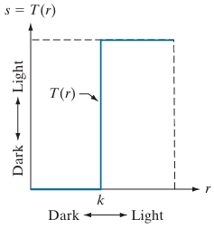
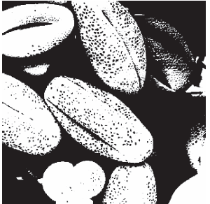
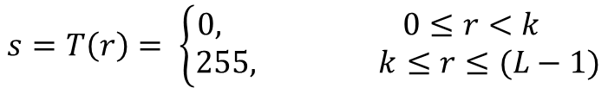
Piecewise Linear Transformations
Thresholding
A technique to convert a grayscale image into a binary image by setting pixels below a threshold to black (0) and those above the threshold to white (255).
$$s=T\left(r\right)= \left\{\begin{aligned}0, 0≤r<k \\ 255, k≤r≤(L−1)\end{aligned}\right.$$

Slide 18
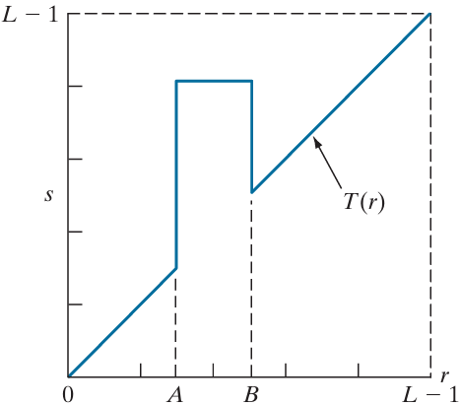
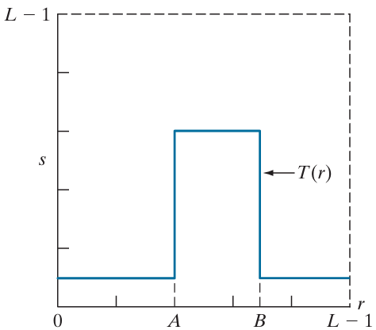
Piecewise Linear Transformations
Intensity-Level Slicing
Highlighting a specific range of intensities in an image often is of interest.
Applications
enhancing features in satellite imagery, such as masses of water, and enhancing flaws in X-ray images
Method 2
Method 1
Highlights range [A ,B ] and reduces all other intensities to a lower level.
Highlights range [A , B] and leaves other intensities unchanged.

Slide 19
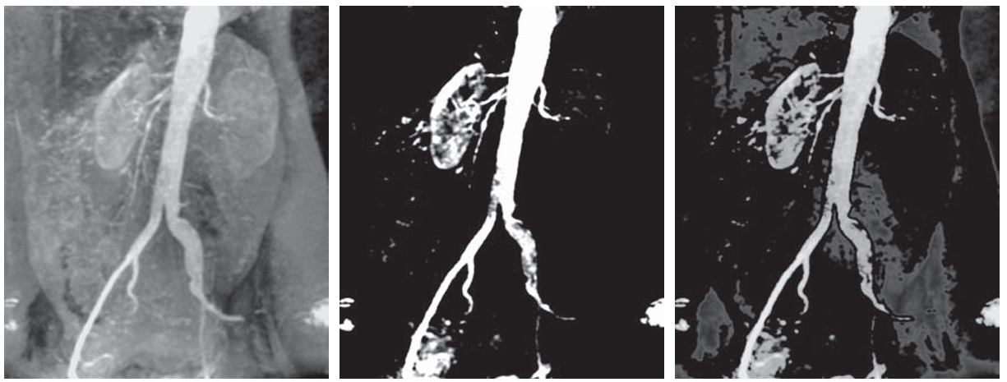
Piecewise Linear Transformations
Intensity-Level Slicing
Original Image
Method 1 result
Method 2 result

Slide 20
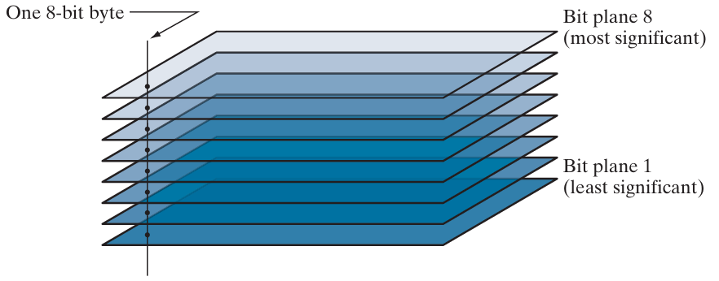
Piecewise Linear Transformations
Bit-Plane Slicing
Highlight the contribution made to total image appearance by specific bits.
Bit-planes of an 8-bit image

Slide 21
Piecewise Linear Transformations
Bit Plane Slicing for 8-bit Grayscale Image
Binary (decimal)
MSB
LSB
8th bit | 7th bit | 6th bit | 5th bit | 4th bit | 3rd bit | 2nd bit | 1st bit
0 (0) | 0 (0) | 0 (0) | 0 (0) | 0 (0) | 0 (0) | 0 (0) | 0 (0)
: | : | : | : | : | 0 (1) | 0 (1) | 1 (1)
: | : | 0 (31) | 0 (15) | 0 (7) | 0 (2) | 1 (2) | 0 (2)
: | 0 (63) | 1 (32) | 1 (16) | 1 (8) | 0 (3) | 1 (3) | 1 (3)
: | 1 (64) | : | : | : | 1 (4) | 0 (4) | 0 (4)
: | : | 1 (63) | 1 (31) | 1 (15) | 1 (5) | 0 (5) | 1 (5)
: | : | 0 (64) | 0 (32) | 0 (16) | 1 (6) | 1 (6) | 0 (6)
0 (127) | 1 (127) | : | : | : | 1 (7) | 1 (7) | 1 (7)
1 (128) | 0 (128) | 0 (95) | 0 (47) | 0 (23) | 0 (8) | 0 (8) | 0 (8)
: | : | 1 (96) | 1 (48) | 1 (24) | 0 (9) | 0 (9) | 1 (9)
: | : | : | : | : | 0 (10) | 1 (10) | 0 (10)
: | 0 (191) | 1 (127) | 1 (63) | 1 (31) | 0 (11) | 1 (11) | 1 (11)
: | 1 (192) | : | : | : | : | : | :
: | : | : | : | : | : | : | :
: | : | : | : | : | : | : | :
1 (255) | 1 (255) | 1 (255) | 1 (255) | 1 (255) | 1 (255) | 1 (255) | 1 (255)
0
255

Slide 22
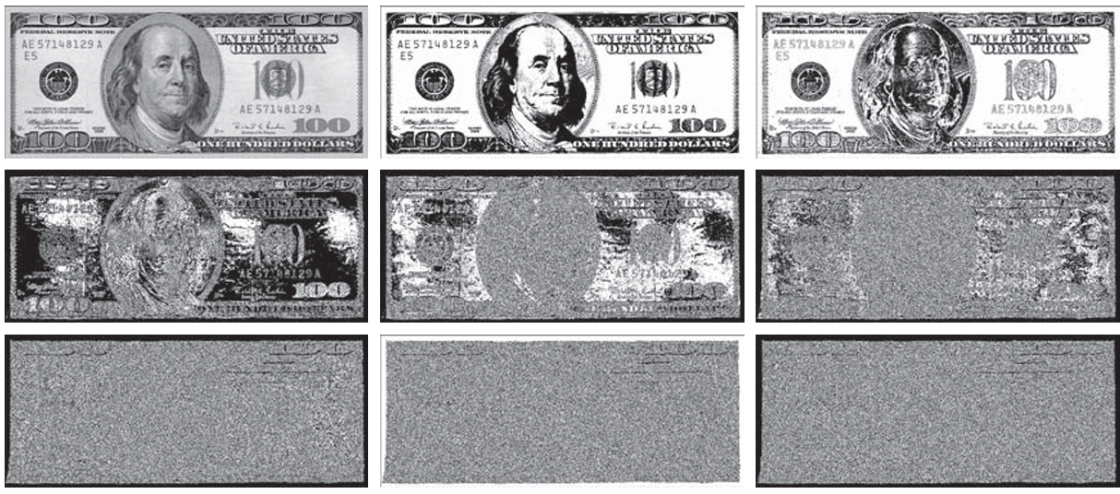
Piecewise Linear Transformations
Bit-Plane Slicing
Original Image
Bit-8 plane
Bit-7 plane
Bit-6 plane
Bit-5 plane
Bit-4 plane
Bit-3 plane
Bit-2 plane
Bit-1 plane

Slide 23
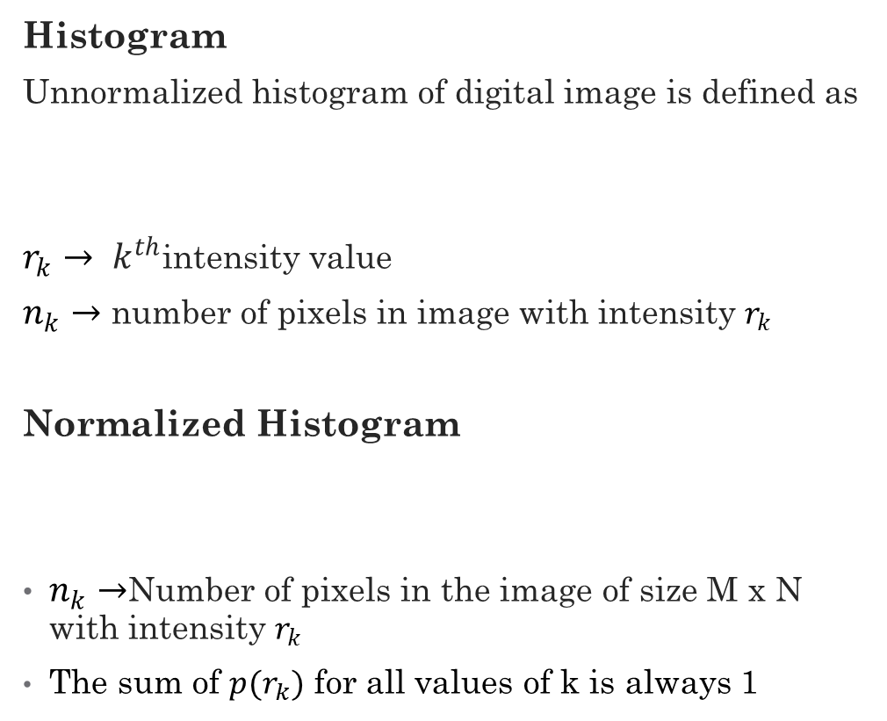
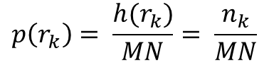
Histogram Processing
Histogram
Unnormalized histogram of digital image is defined as
$r_{k}→ k^{th}$intensity value
$n_{k}→$ number of pixels in image with intensity $r_{k}$
Normalized Histogram
$n_{k}→$Number of pixels in the image of size M x N with intensity $r_{k}$
The sum of $p(r_{k})$ for all values of k is always 1
image
3 | 2 | 5
3 | 1 | 3
4 | 5 | 0
6 | 7 | 4
$$h\left(r_{k}\right)= n_{k} for k=0, 1, 2,…….., L−1$$
$$p\left(r_{k}\right)= \frac{h(r_{k})}{MN}= \frac{n_{k}}{MN}$$

Slide 24
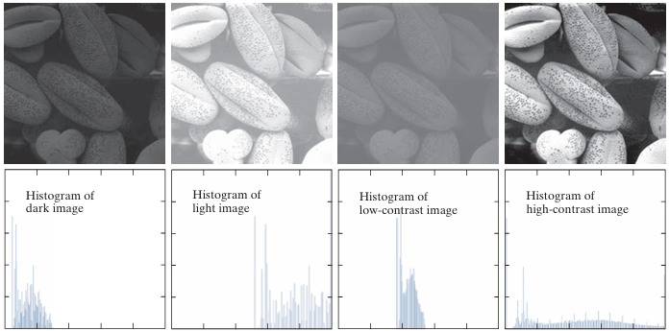
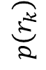
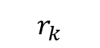
Histogram Processing
Dark
Light
Low contrast
High contrast
$$p\left(r_{k}\right)$$
$$r_{k}$$

Slide 25
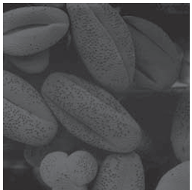
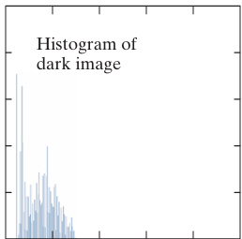
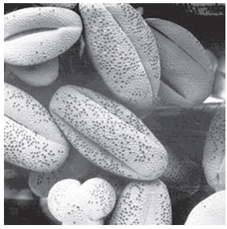
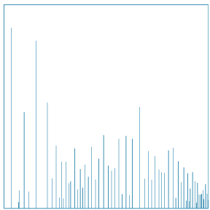
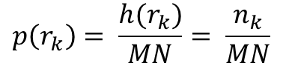
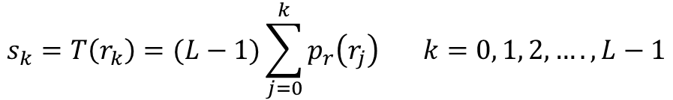
Histogram Processing
Histogram Equalization
Histogram equalization is the process of uniformly distributing the image histogram over the entire intensity axis by choosing a proper intensity transformation function.
Equalized Histogram
Transformation function
L -> #intensity levels in the image
$$p\left(r_{k}\right)= \frac{h(r_{k})}{MN}= \frac{n_{k}}{MN}$$
Dark image
Dark image histogram
$$s_{k}=T\left(r_{k}\right)=(L−1)\sum_{j=0}^{k}{p_{r}\left(r_{j}\right) k=0, 1, 2, …., L−1}$$
Histogram-equalized image
Equalized histogram

Slide 26
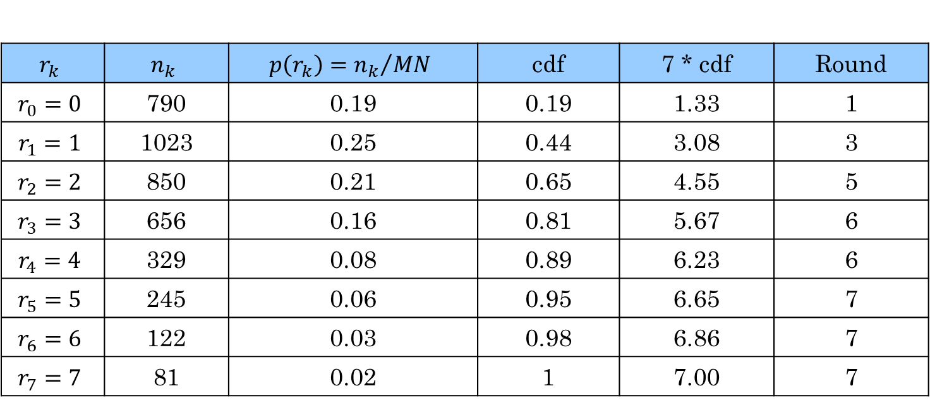
Histogram Processing
Histogram Equalization Example
Suppose a 3-bit image (L=8) of size 64 x 64, pixels (MN = 4096)
$$r_{k}$$ | $$n_{k}$$ | $$p\left(r_{k}\right)={n_{k}}/{MN}$$ | cdf | 7 * cdf | Round
$$r_{0}=0$$ | 790 | 0.19 | 0.19 | 1.33 | 1
$$r_{1}=1$$ | 1023 | 0.25 | 0.44 | 3.08 | 3
$$r_{2}=2$$ | 850 | 0.21 | 0.65 | 4.55 | 5
$$r_{3}=3$$ | 656 | 0.16 | 0.81 | 5.67 | 6
$$r_{4}=4$$ | 329 | 0.08 | 0.89 | 6.23 | 6
$$r_{5}=5$$ | 245 | 0.06 | 0.95 | 6.65 | 7
$$r_{6}=6$$ | 122 | 0.03 | 0.98 | 6.86 | 7
$$r_{7}=7$$ | 81 | 0.02 | 1 | 7.00 | 7
These are the values of the equalized histogram

Slide 27
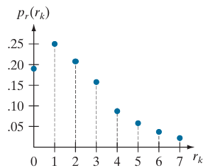
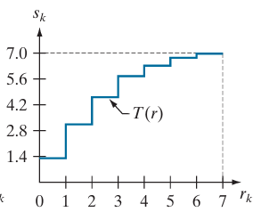
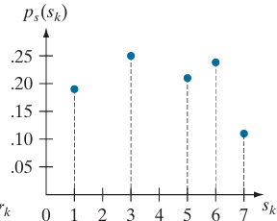
Histogram Processing
Histogram Equalization Example
Original histogram
Transformation function
Equalized histogram

Slide 29
Thank You

